Slide 1

World record Soaring trough the clouds LIve demo of 19 Oracle Public cloud services
The Oracle ACE Soaring Clouds Team
Oracle OpenWorld 2017
2nd October 2017, San Francisco, USA

Slide 2
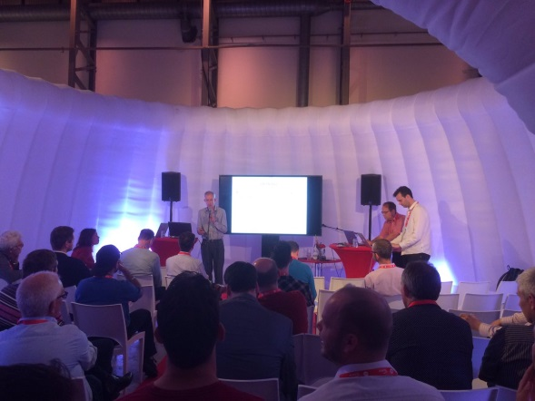
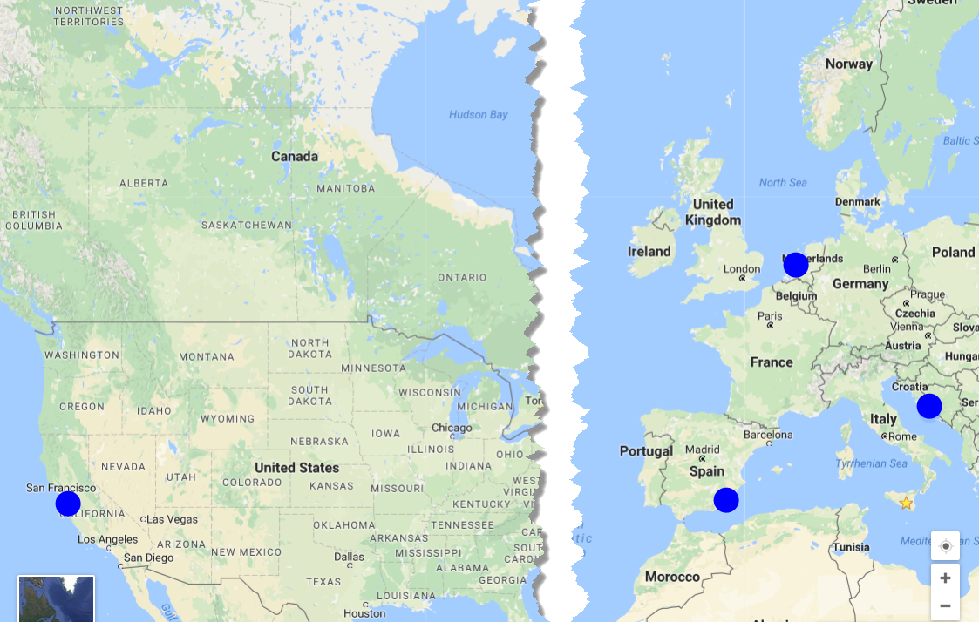
Soaring through the clouds
Prepared by international team of Oracle ACEs
Presented five times before today:
Valencia, Spain, March 2016
Katwijk, Netherlands, June 2016
San Francisco, USA, September 2016
Split, Croatia, March 2017
Amersfoort, Netherlands, June 2017
Objective: demonstrate live a working end-to-end integrated flow using Oracle PaaS Cloud Services
and provide insight in how it is created and what the main challenges were

Slide 3


end-to-end integrated flow using AS MANY Oracle PaaS Cloud Services as possible

Slide 4

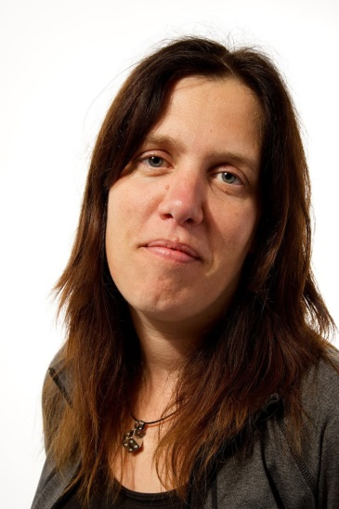
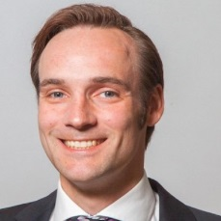

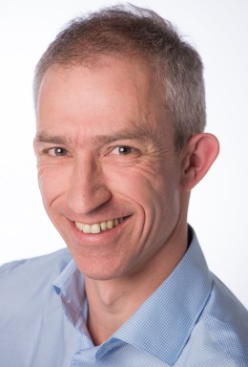
The Team
Distributed
Three countries, Four partners, Five Locations
The Cloud is omnipresent
except when there is a form of outage

Slide 5




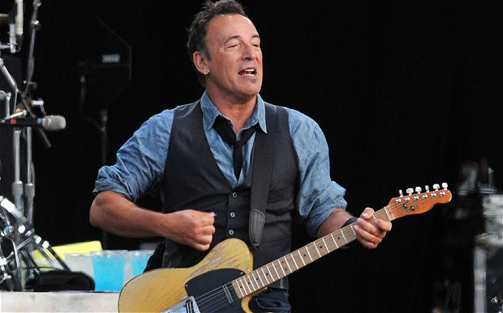
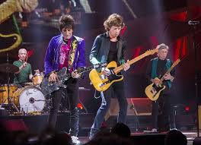
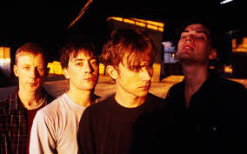
Business scenario (2016)
Analyze Twitter traffic
& Voting Machines
Evaluate Proposal
Publish Enriched Approved Proposals on Web Portal
Oracle OpenWorld 2017

Slide 6
Extended business scenario (2017)
Provide end to end monitoring at business and IT level
Analyze Twitter traffic
& Voting Machines
Lower cost/increase speed of using 3rd party APIs
Send email,
Update Document, …
Evaluate Proposal
Publish Enriched Approved Proposals on Web Portal
Access Artist proposal through Chat client
Publish Business APIs
Publish through Mobile App
Use automated collaboration platform with source control and continuous delivery
Oracle OpenWorld 2017
Data Visualization
Social Media integration

Slide 7
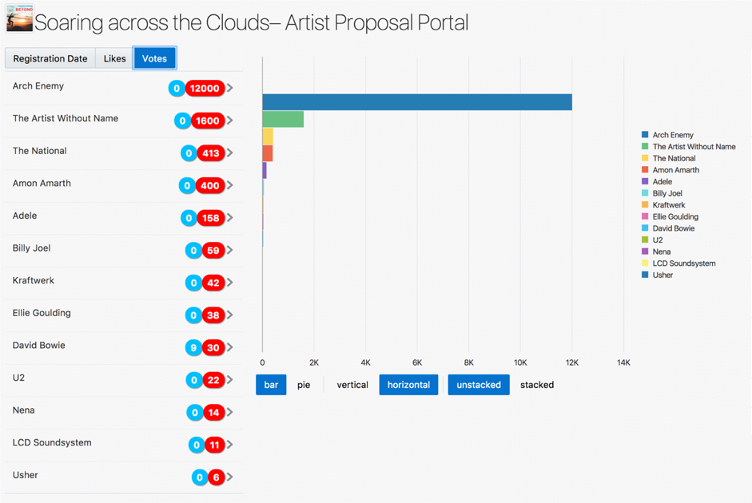
The Conference Artist Proposals Portal

Slide 8
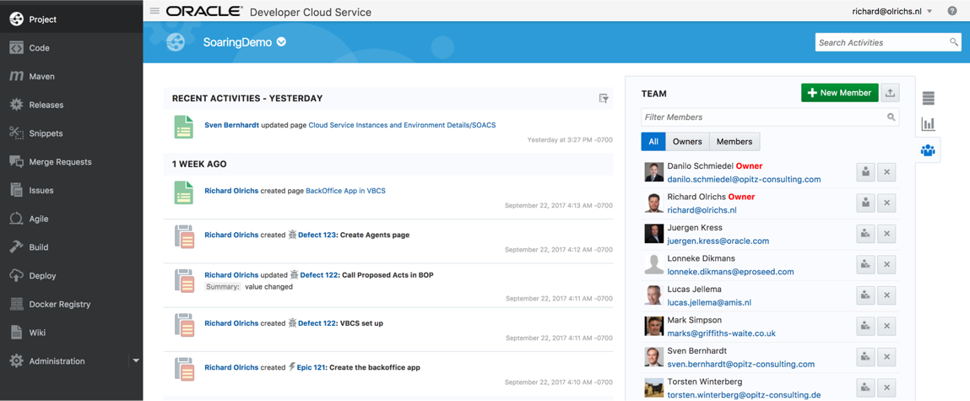
Developer cloud service – project management, source control, automated build & deploy

Slide 9


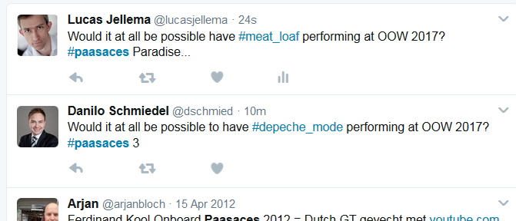
Now you tweet your Artist Proposal for OOW 2017
Use the hashtag #paasaces to get noticed
and add your favorite artist using another hashtag
Note: use underscore for space
Notes:
Invite audience to start tweeting. Show that tweets are coming in. Ensure that we soon have a winner…. (have some tweets or co-conspirators prepared; or: ask someone in the audience for their favorite and send multiple tweets to have that artist put forward)

Slide 10
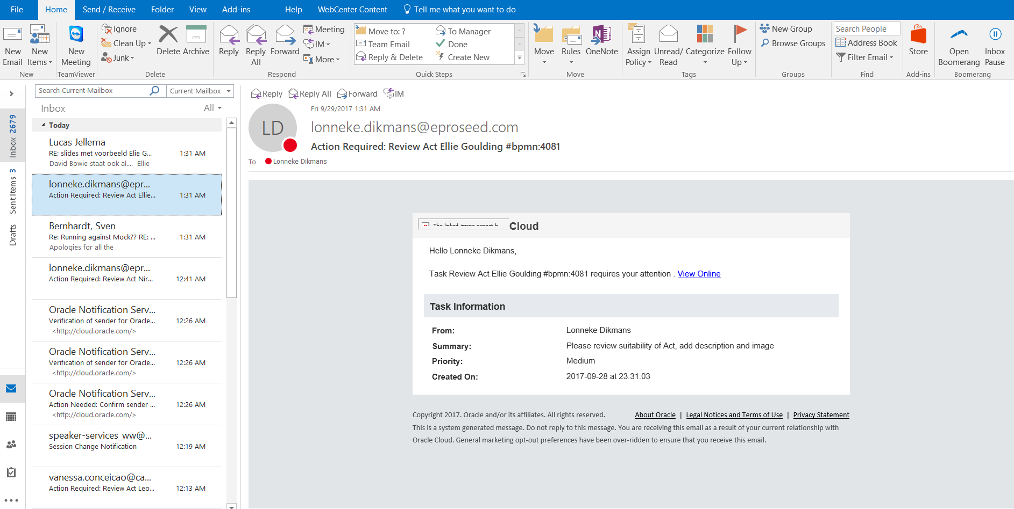
A proposal comes in

Slide 11
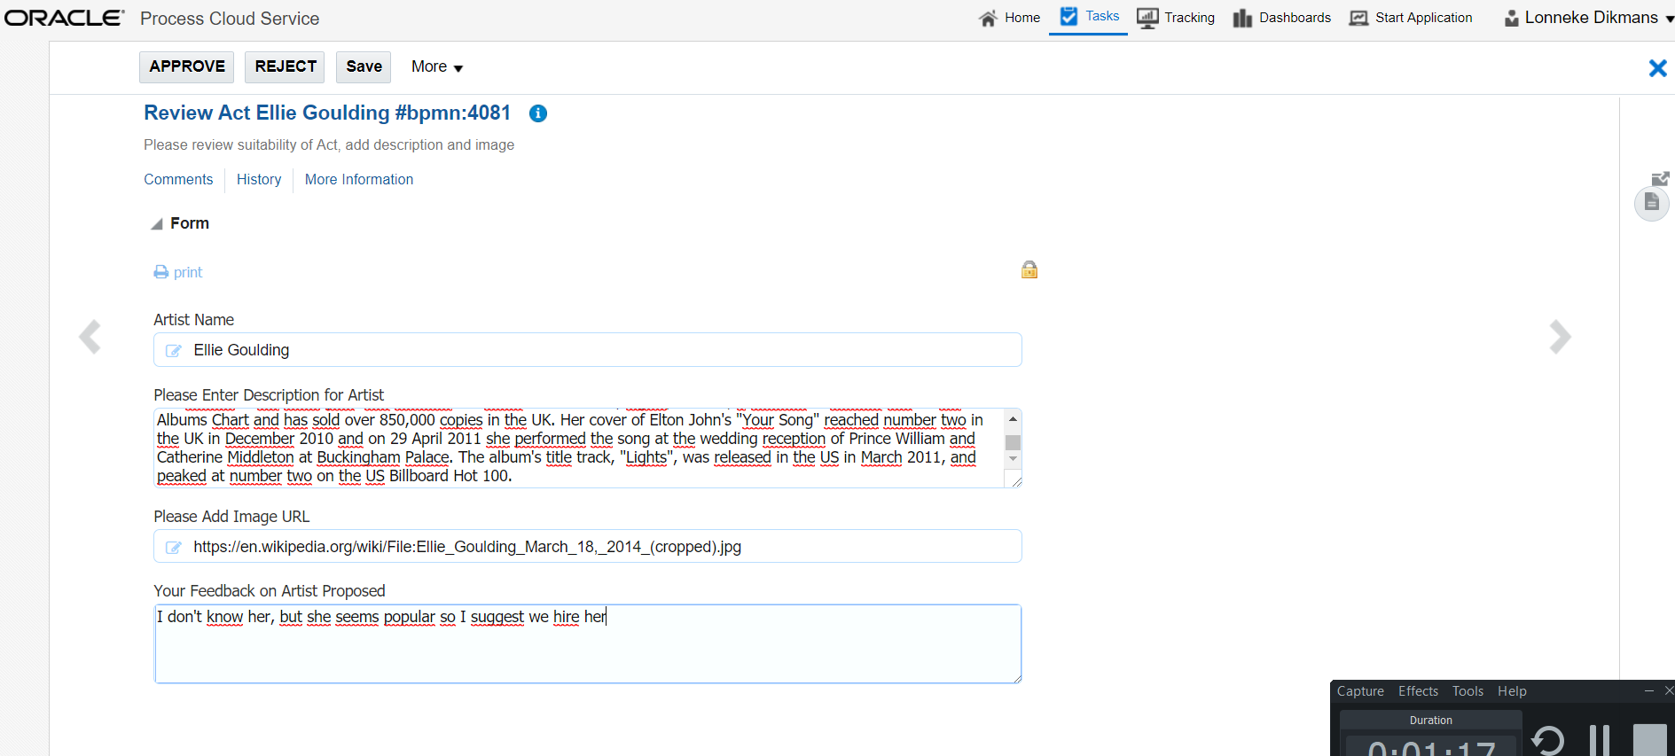
Open Task

Slide 12
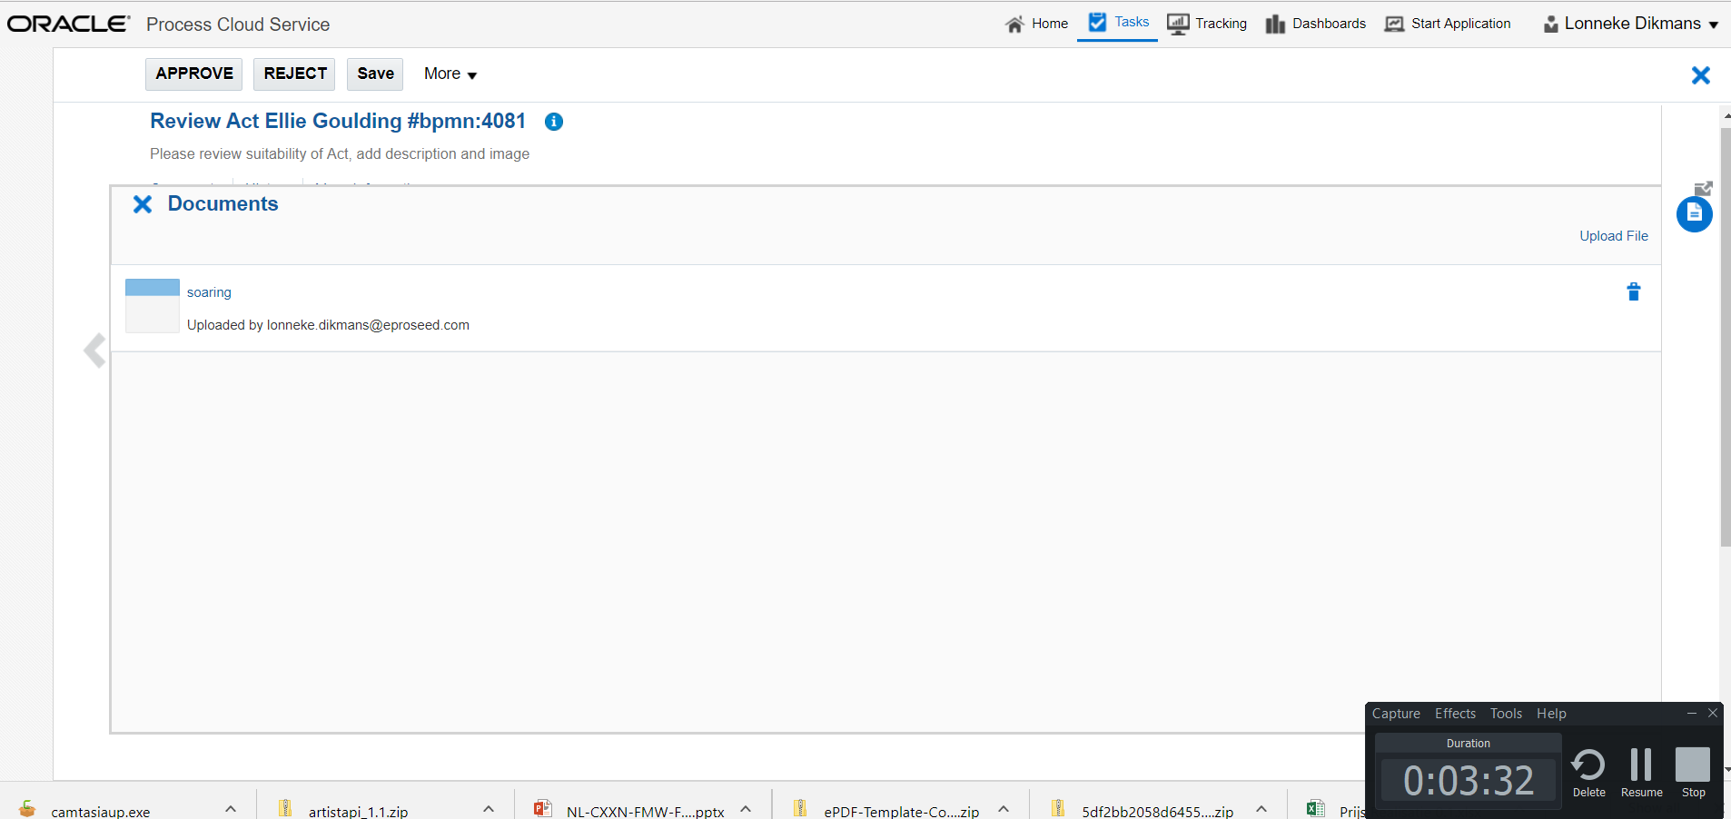
Show document

Slide 13
Approve task

Slide 14
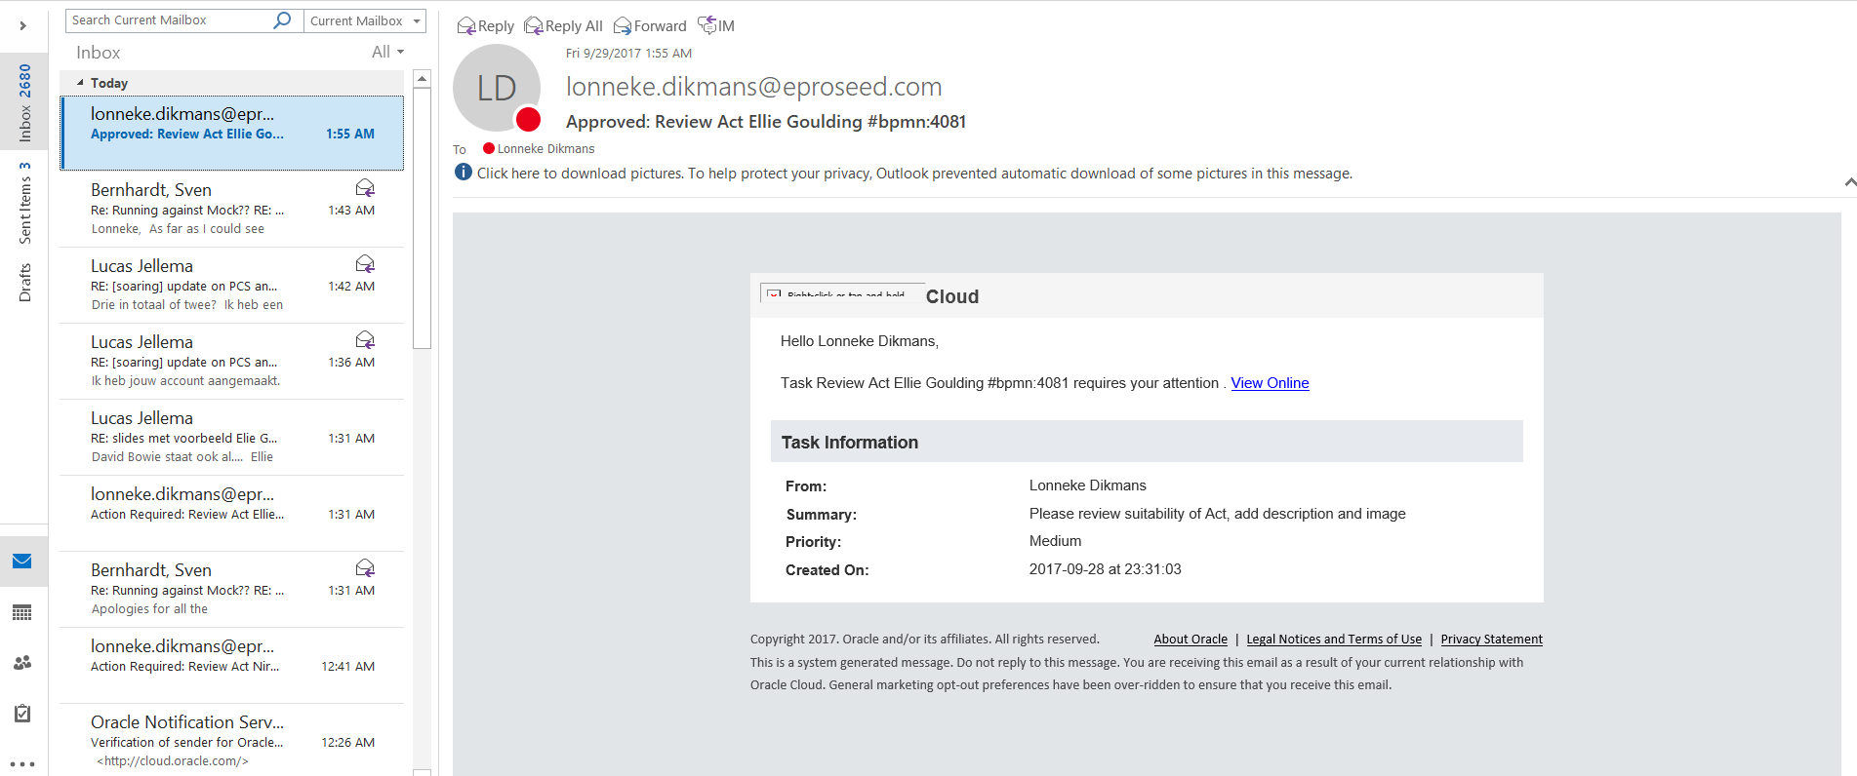
Approve task

Slide 15
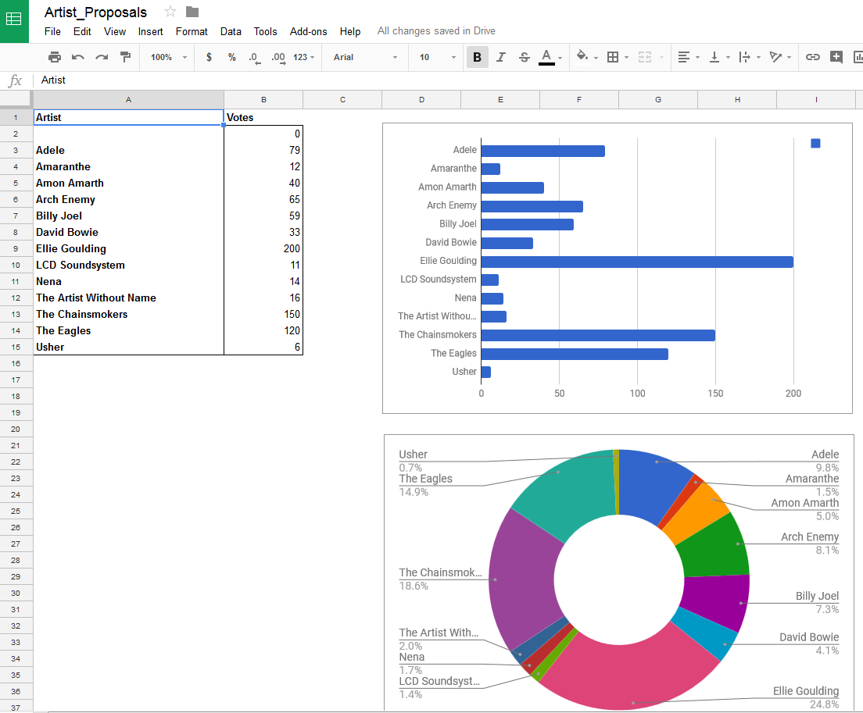
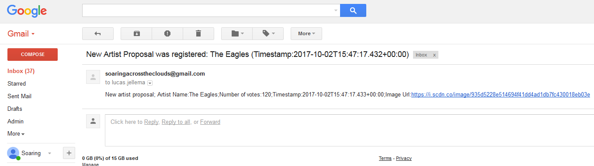

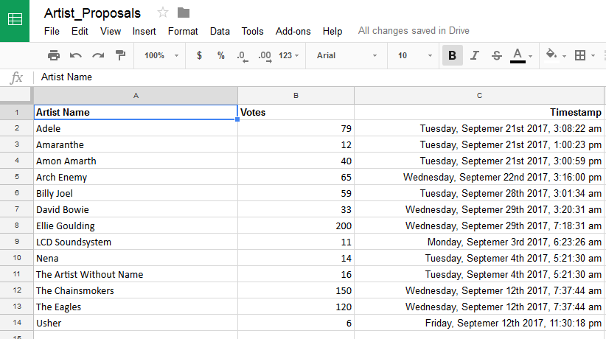
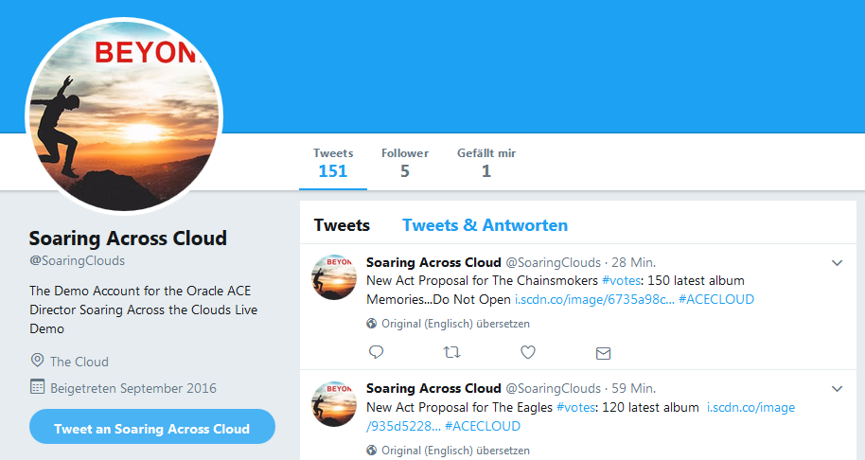

Activate Social media Twitter, Email, Google Docs
(O)SSI

Slide 16
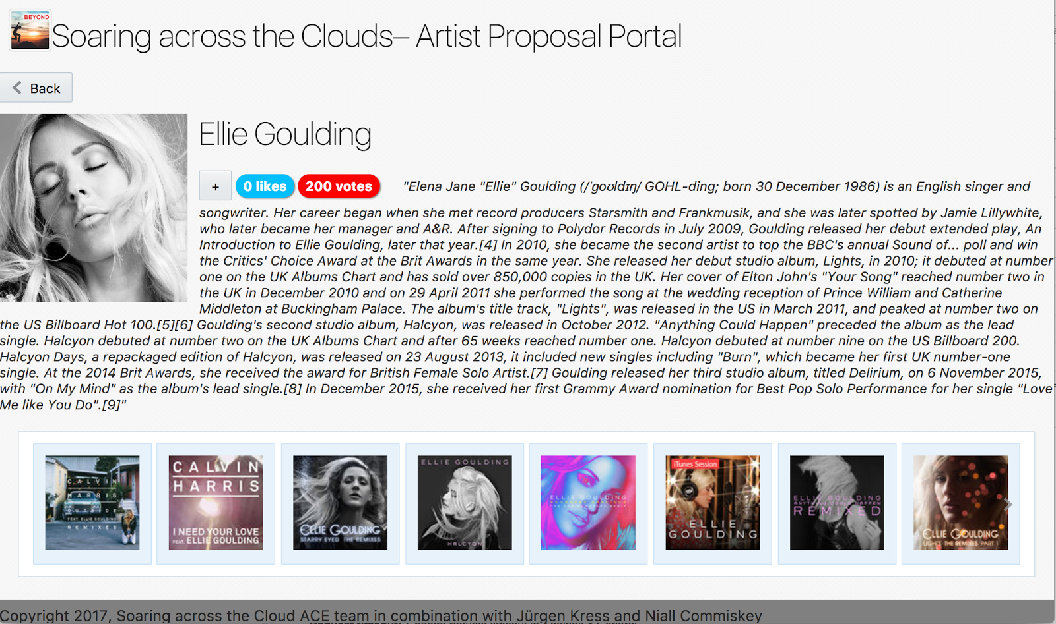
Conference Artist Proposals Portal with the new proposal and artist enrichment

Slide 17
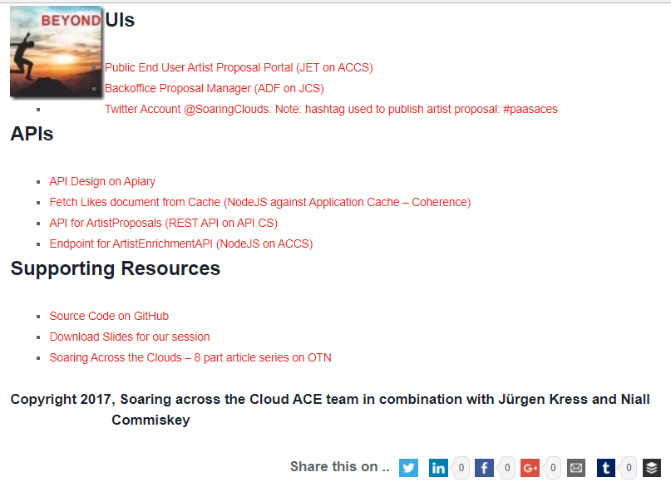
Live Endpoints & Resources for you to access
http://tinyurl.com/soaringpaas

Slide 18
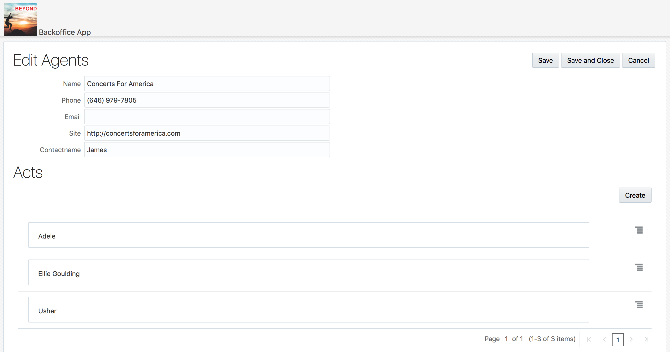
Event organizer’s backoffice application – Visual Builder Cloud Service
Notes:
create an event organizer’s backoffice application – using REST APIs to get the list of proposed artists and adding VBCS data objects to record information about the artist’s rate , agent contact details and other backoffice details.

Slide 19

Do it yourself
Download the MAX Application from the Apple Store or Google Play
Read the QR code
Login with Mobileuser / soaringOOW17

Slide 20
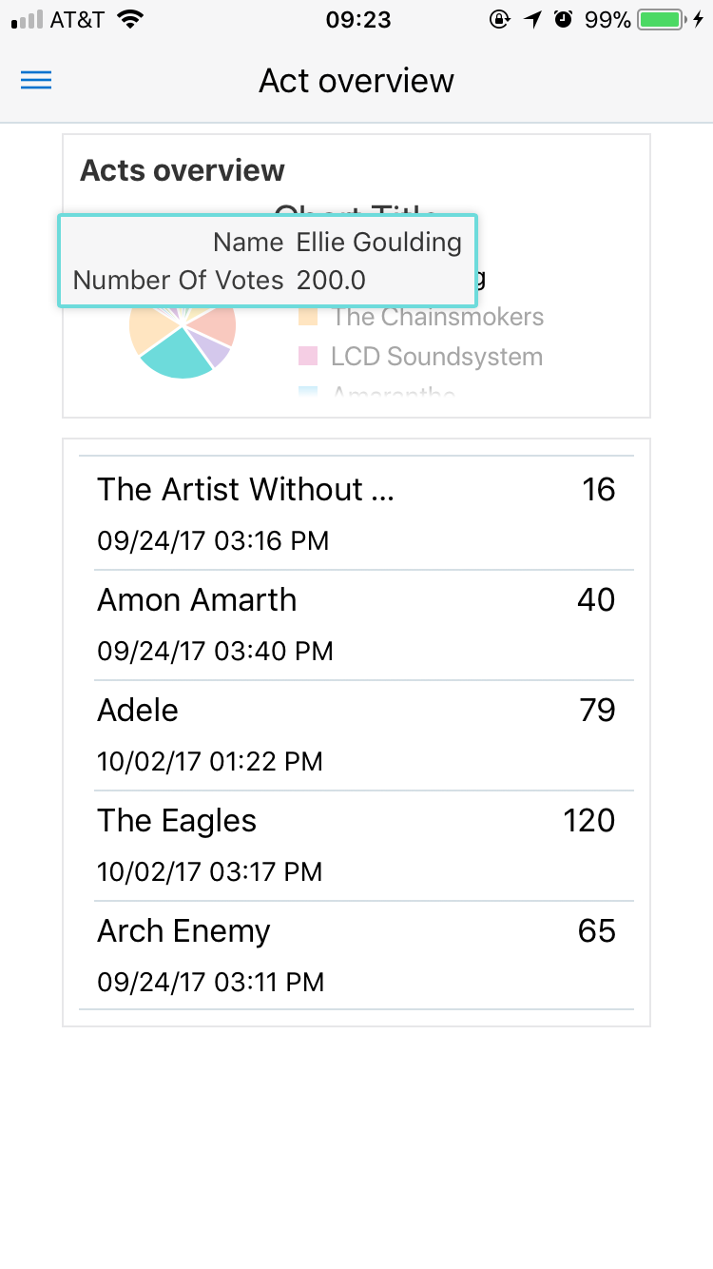
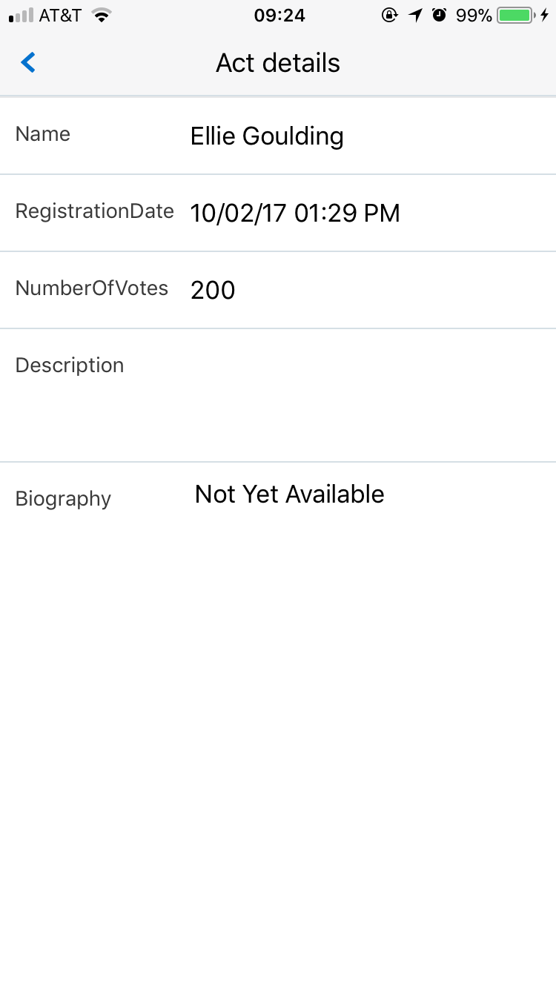
Artist overview and details

Slide 21
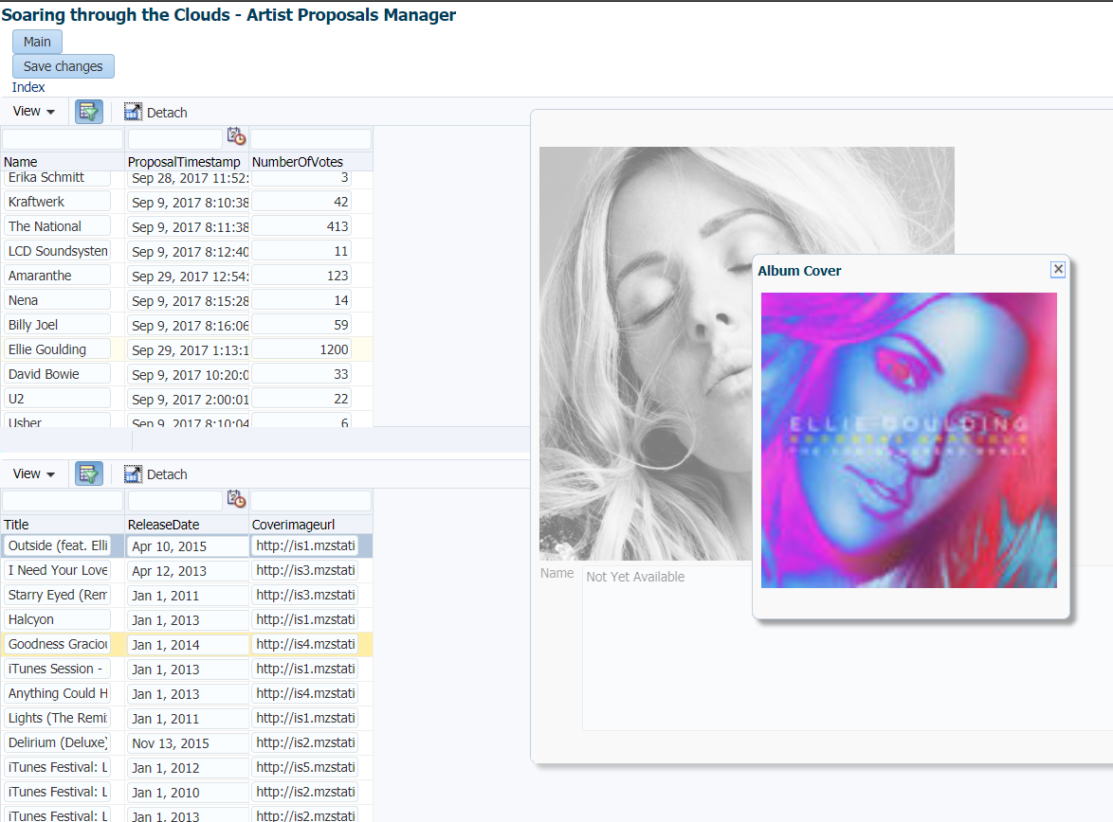
Artist proposal back office raw data management application

Slide 22
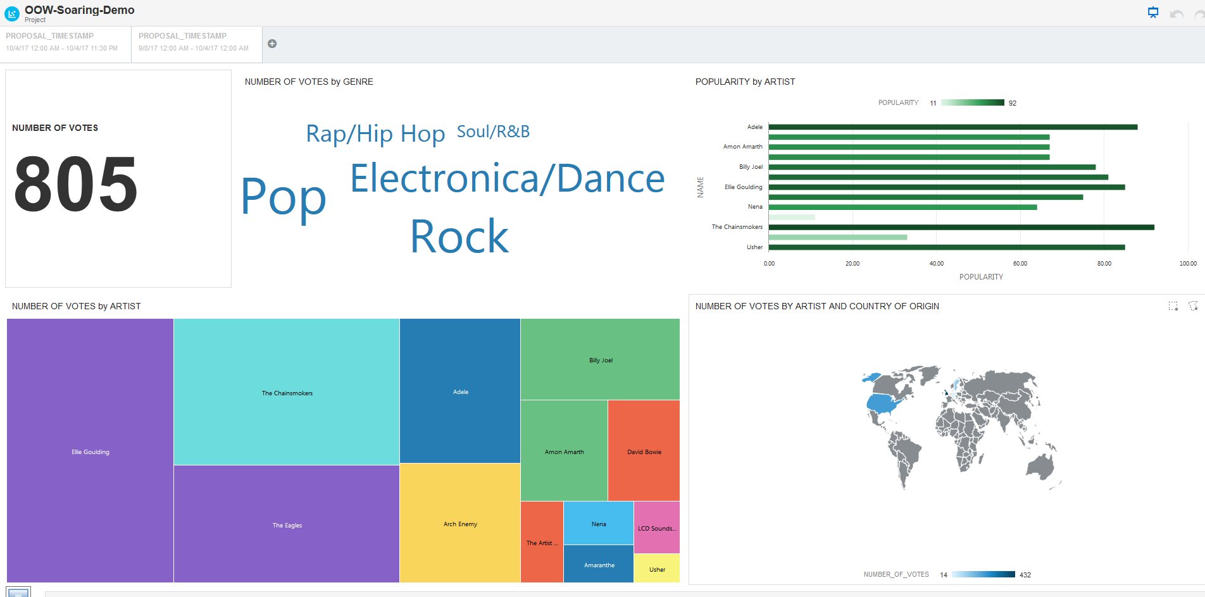
Data visualization and data analysis – citizen data science

Slide 23
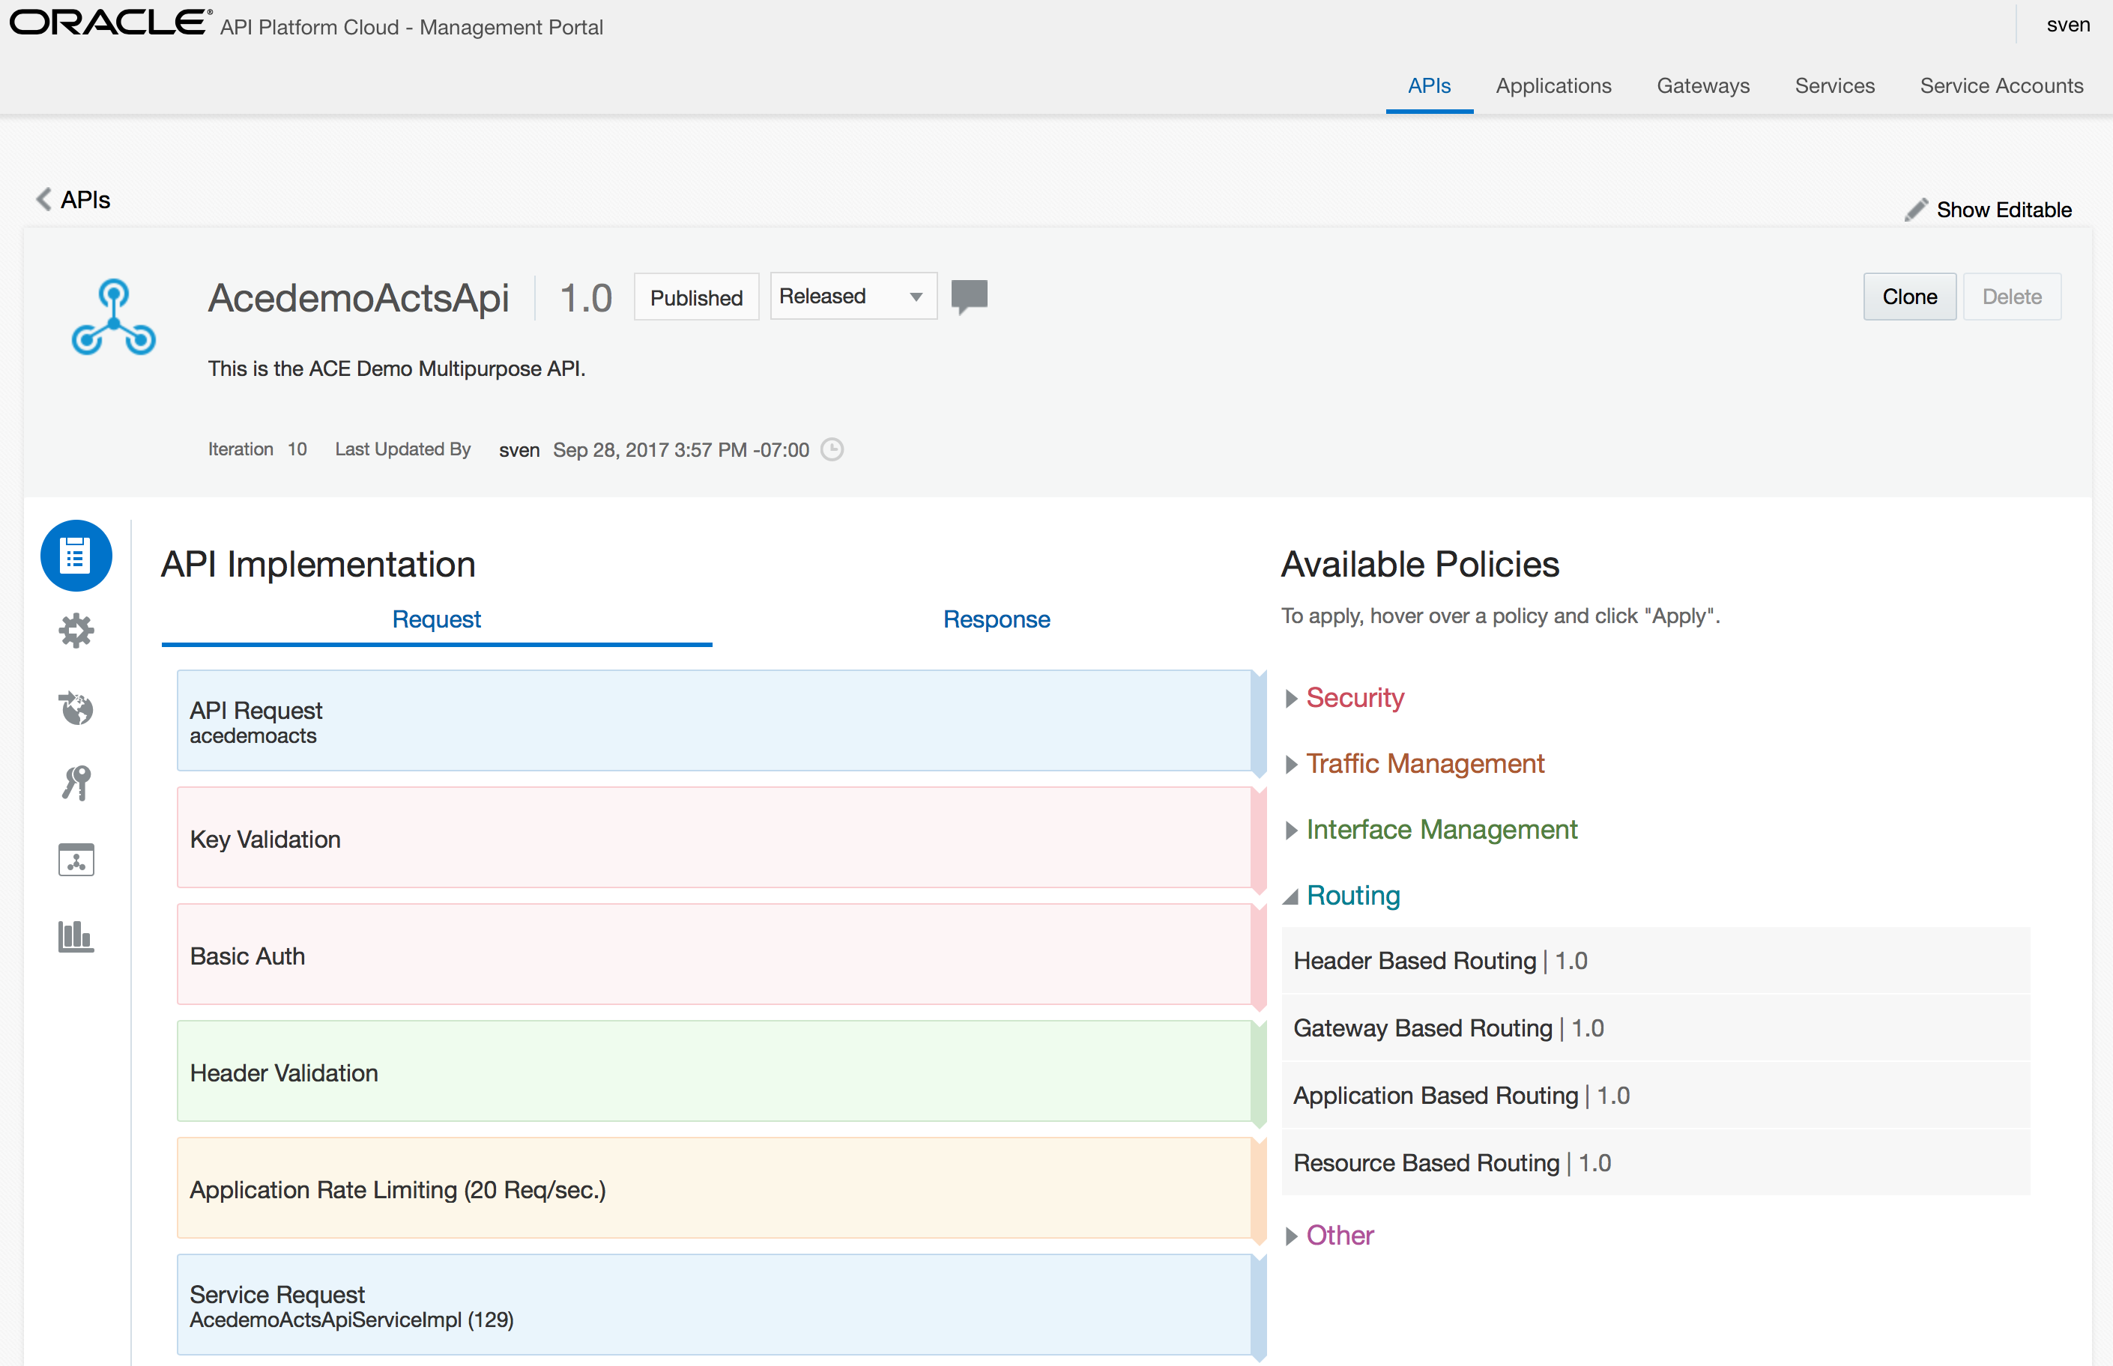
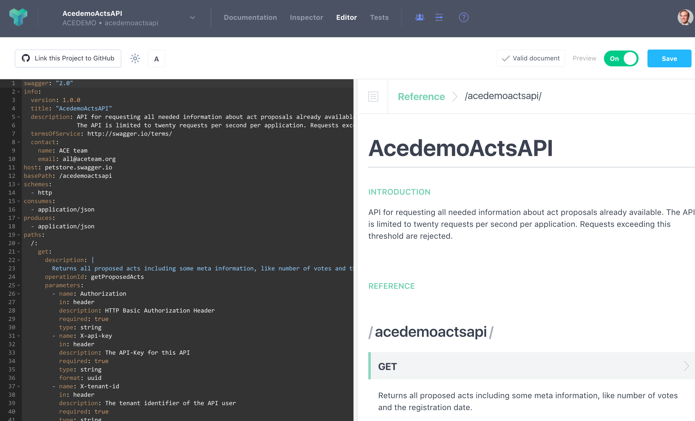
Public APIs for accessing Artist proposal details
Notes:
@Sven
Screenshot:
API Portal with design details for APIs
Postman example call with returned details about artist
Demo
Show an API in API CS ;
invoke that API (from Postman?) and show that the new artist details are returned

Slide 24
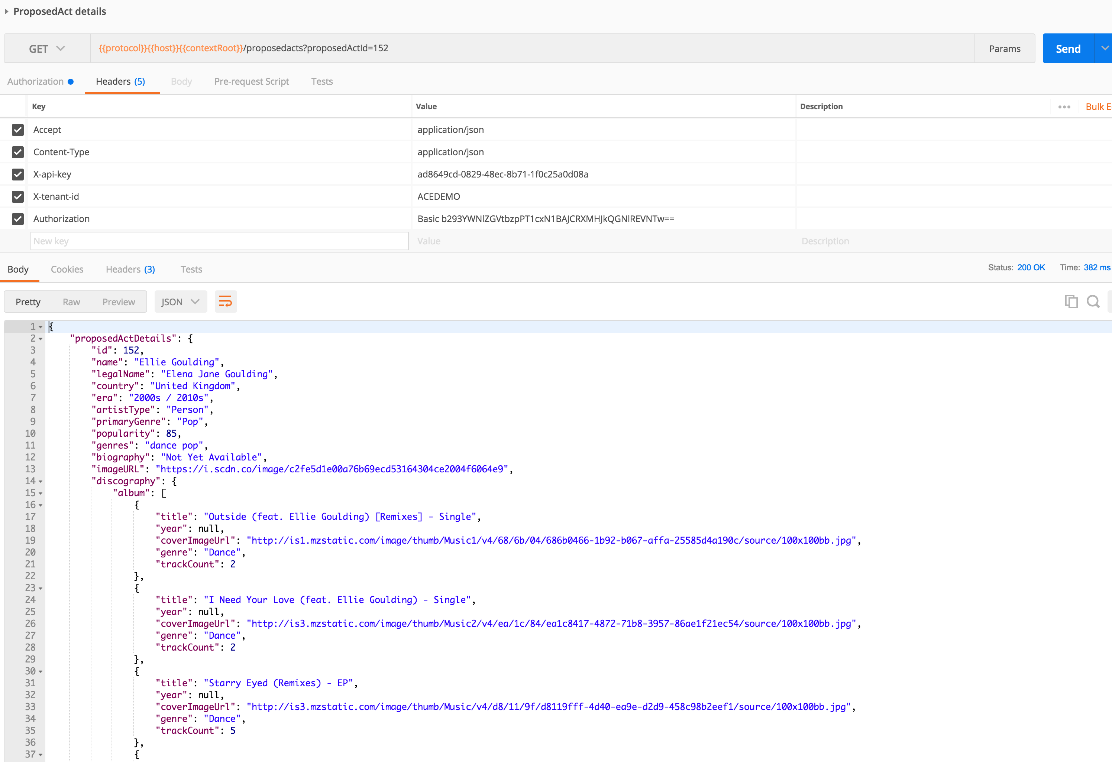
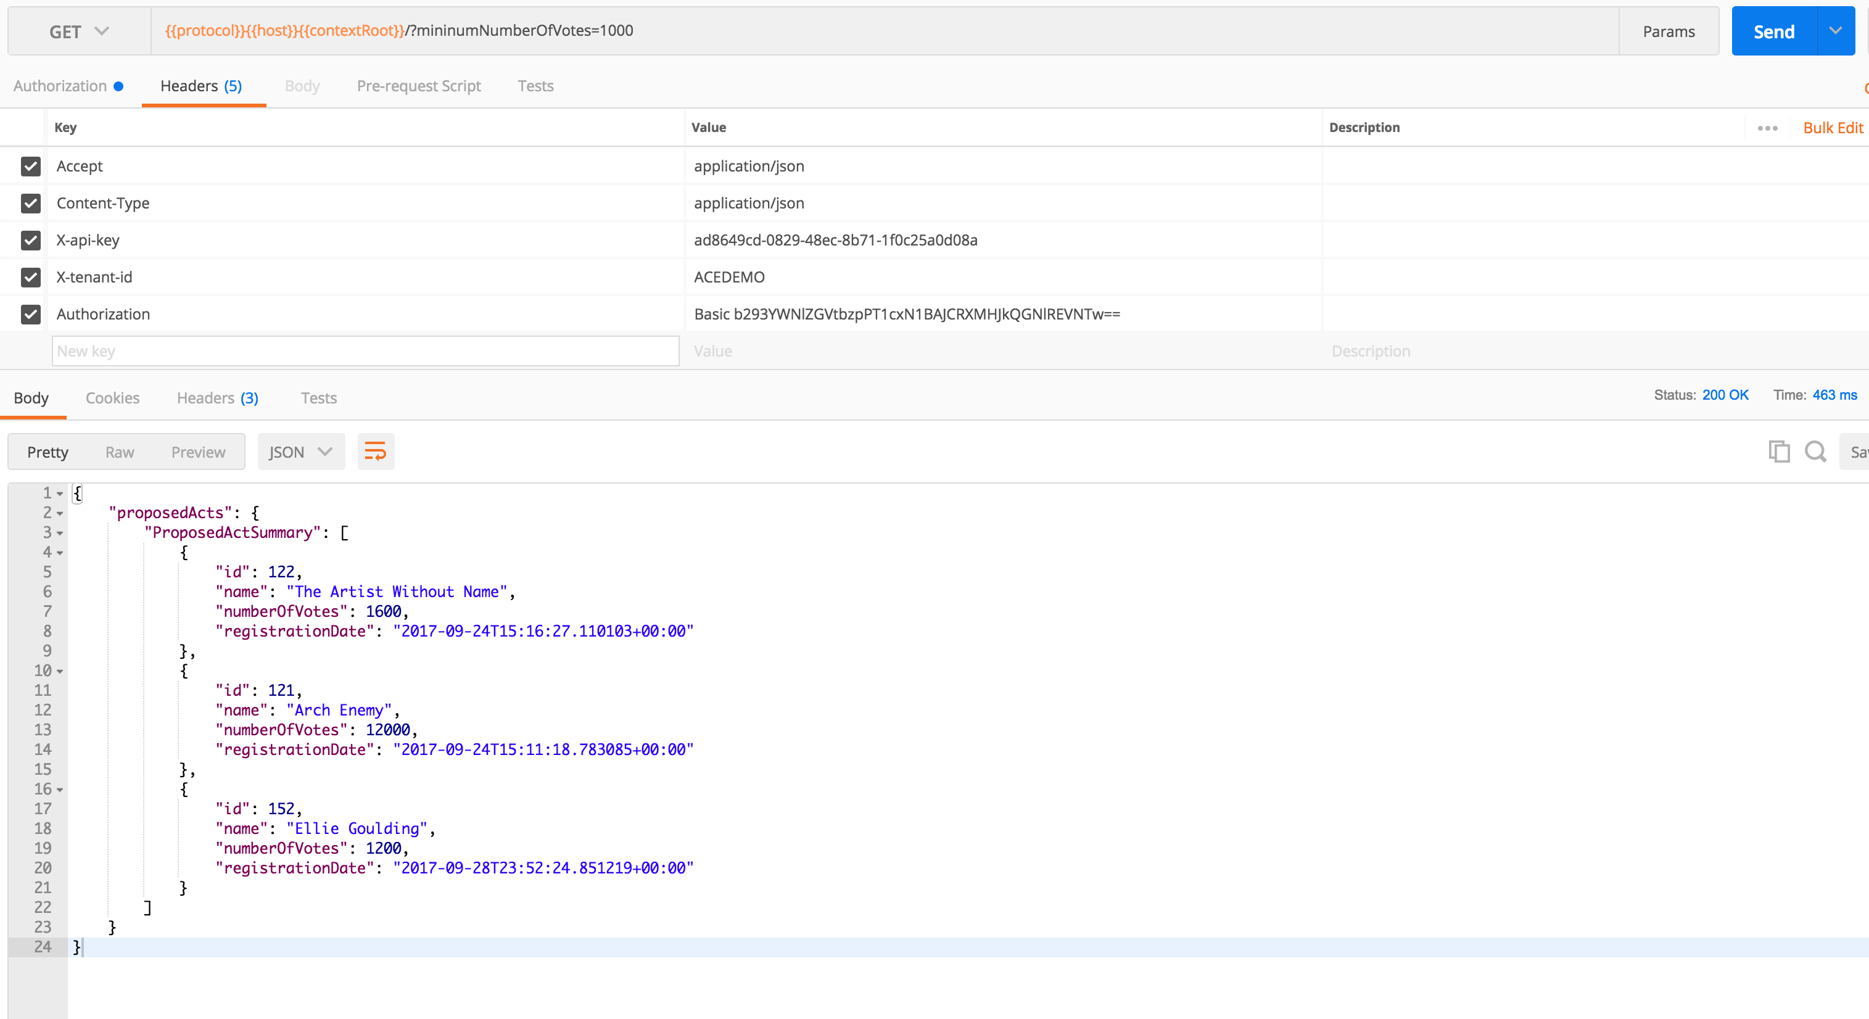
Public APIs for accessing Artist proposal details

Slide 25










cloud solution architecture
Data Visualization
Application Cache
(O)SSI
DBaaS
ACCS
Event Hub
SOA CS
ADF on JCS
Visual Builder Cloud Service
API P
MCS
JET on
Appplication Container CS
MAX

Slide 26
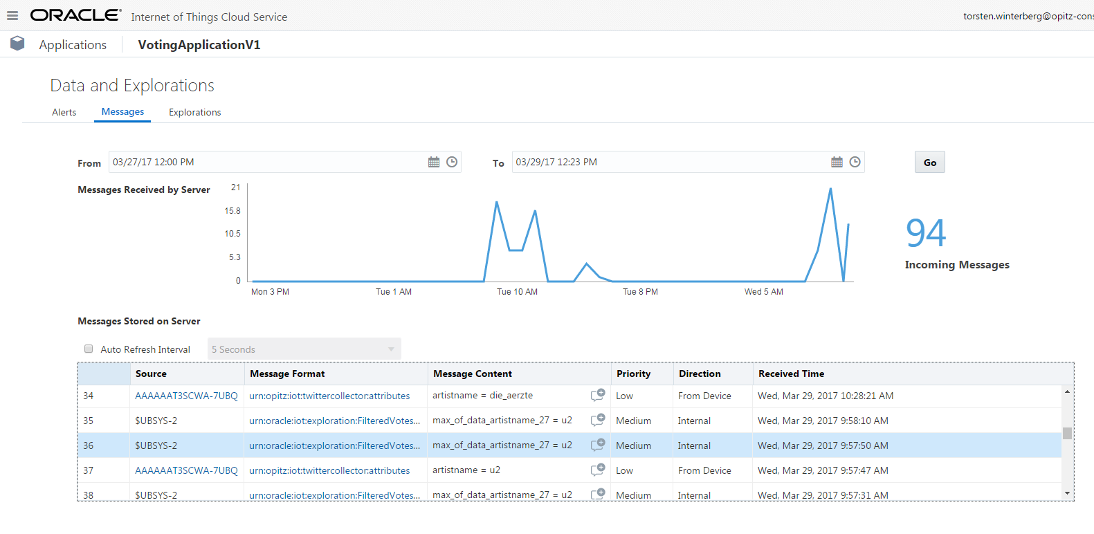
Triggering artist proposal approval from physical things or social media

Slide 27
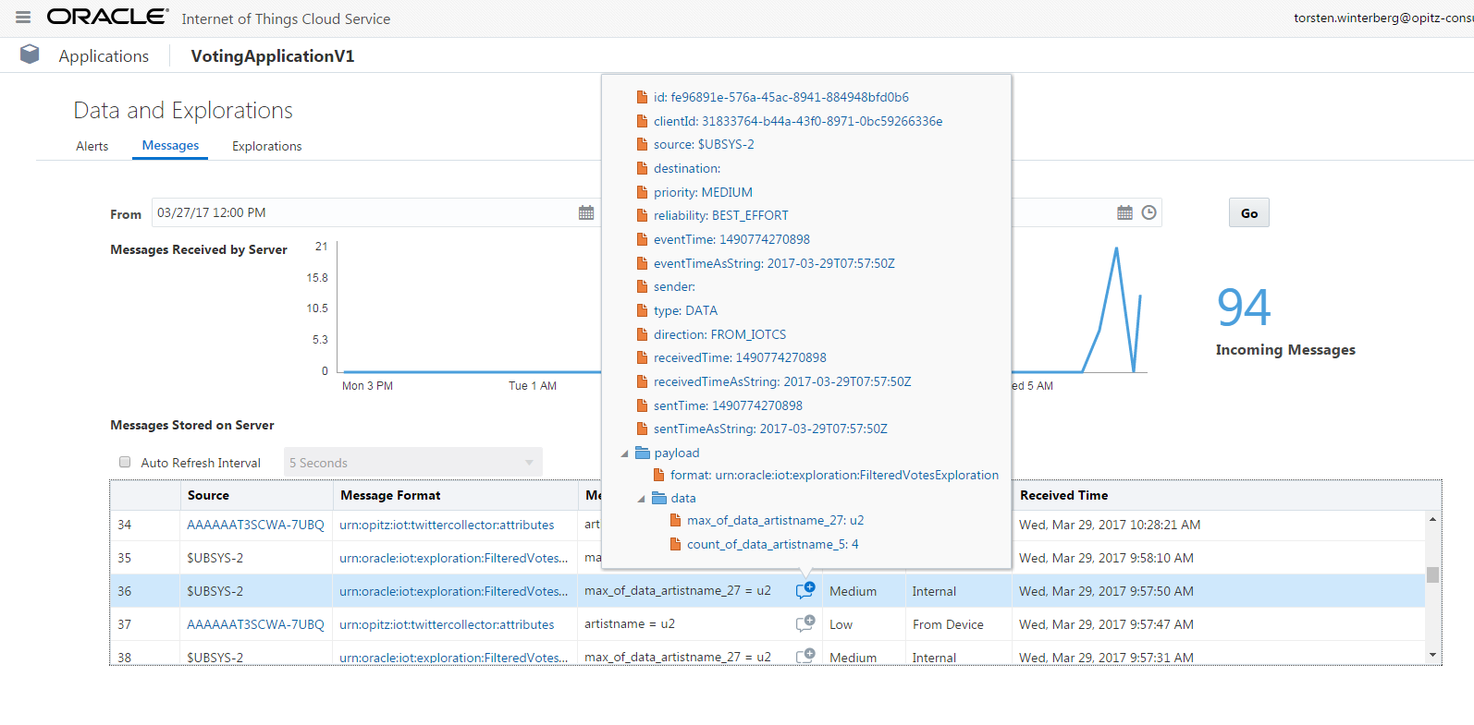
Triggering artist proposal approval from physical things or social media (2)

Slide 28
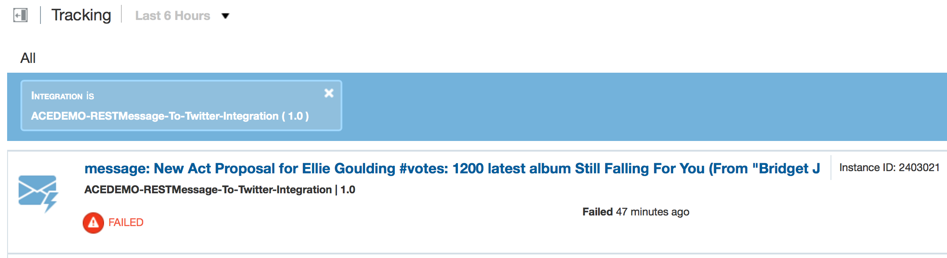
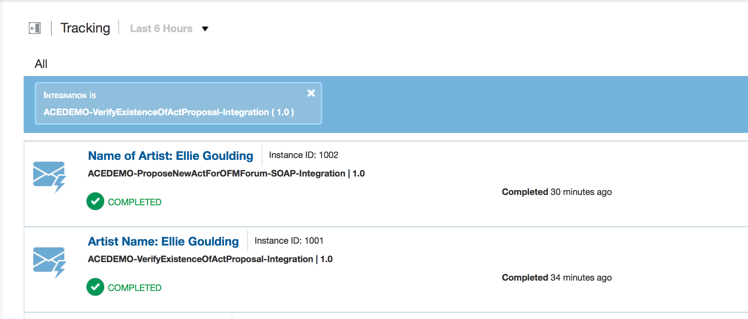

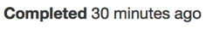
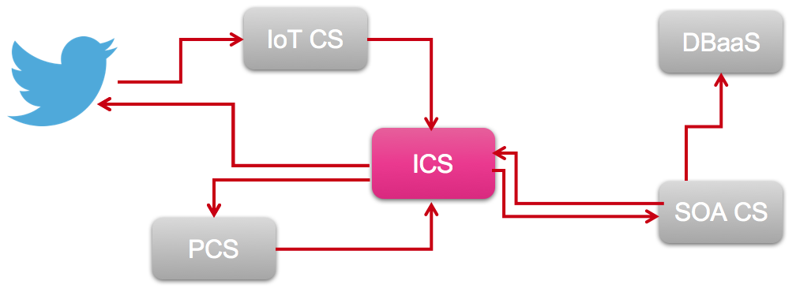
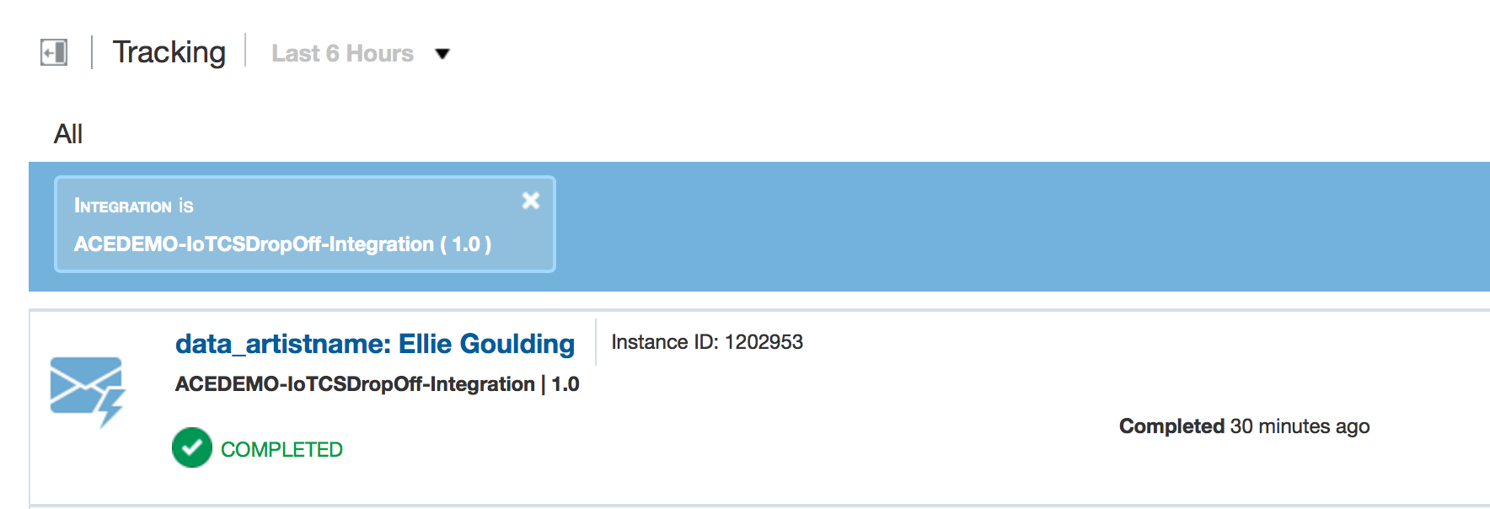
The man in the middle - hooking up IOT, process cloud and back office Database
3
2
1
Notes:
@Sven
Screenshot
ICS business indicators/instances for new artist for IOT => PCS and PCS => SOA CS – showing new artist
Demo
Show ICS monitor/business indicators/instances for new artist point out the flow from IoT CS -> PCS, PCS -> SOA CS (twice)

Slide 29

And some more cloud solution architecture
Real “Things” (Pis, Arduino’s, …)
Audience
IoT CS
DBaaS
ICS
Content & Experience
SOA CS
PCS
Doc CS
Conversations (OSN)

Slide 30
Some of the underlying foundational infrastructure cloud services
Real “Things” (Pis, Arduino’s, …)
Audience
IoT CS
DBaaS
Compute
ICS
Storage
Compute
SOA CS
Storage
JCS
DBaaS
JCS
Compute
DBaaS
Storage
Compute
Storage

Slide 31
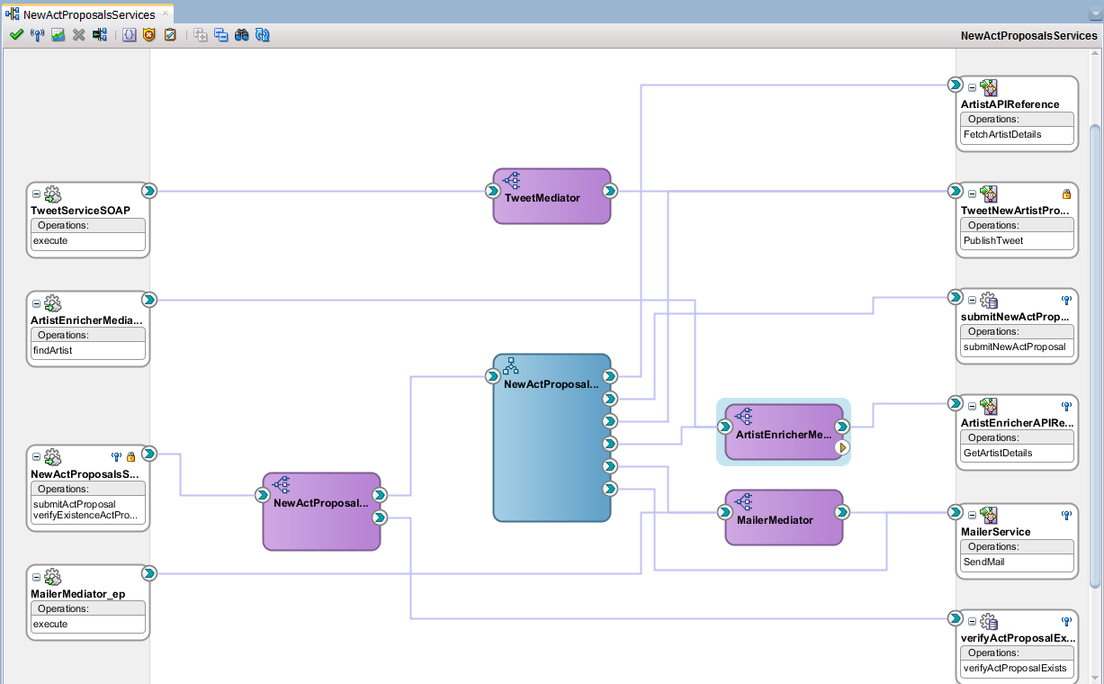
SOA CS

Slide 32
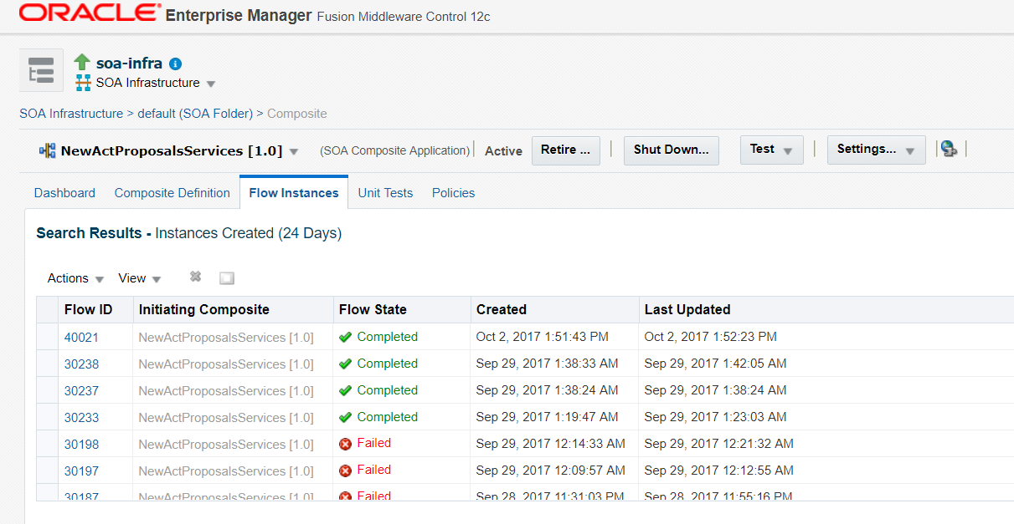
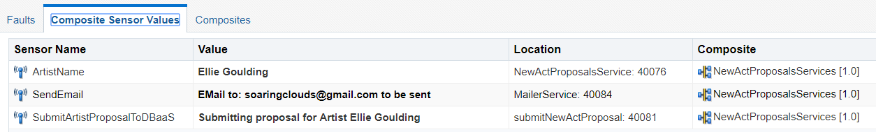
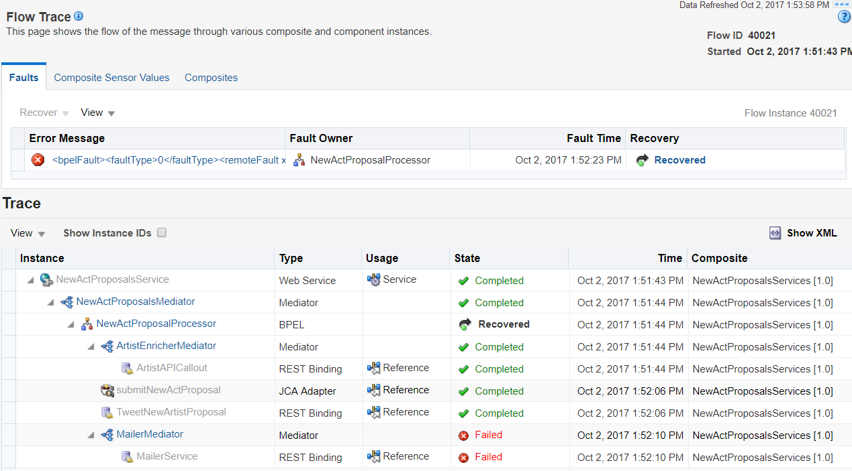

Slide 33
Remember that new feature?
Incident created in Dev CS
Feature implemented in JET
New release was built and deployed from DevCS to ACCS
Refresh the Portal application in your browser
Et voila
Notes:
Show the new feature in the Portal, discussed in step 3 and developed/built/deployed in Dev CS during the session; show briefly in DevCS what the steps are: code committed for the feature; build executed/deployment executed to ACC (or other target cloud)

Slide 34
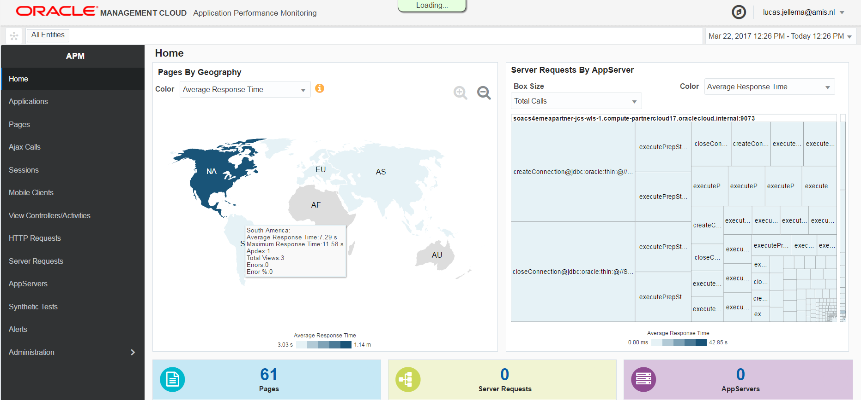
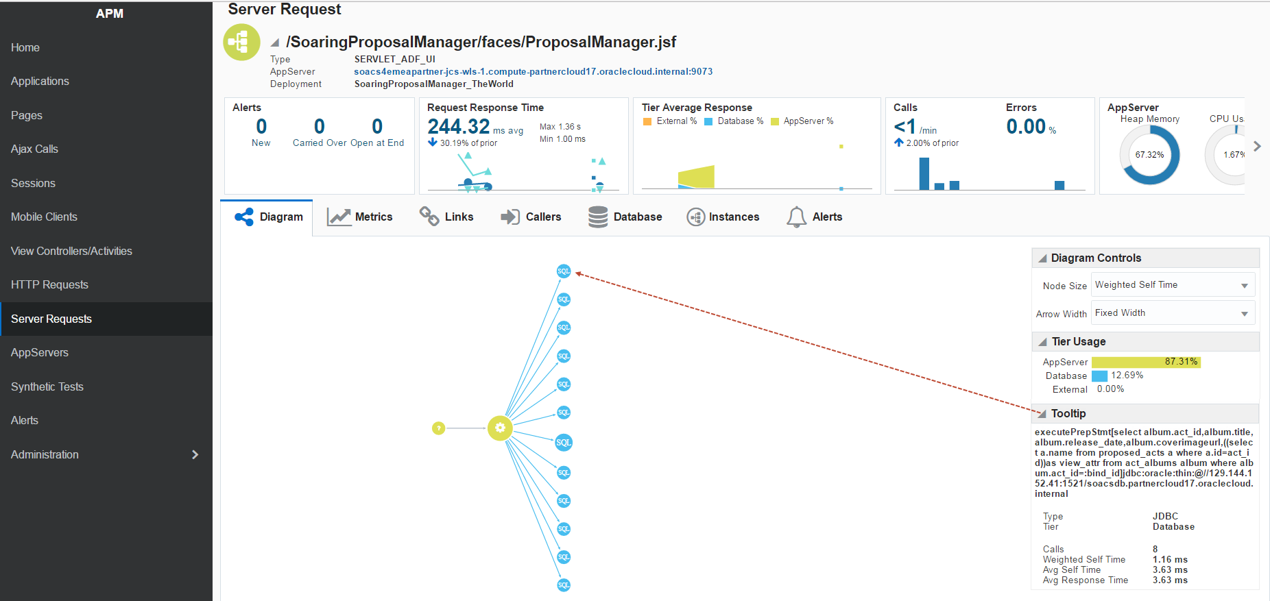
OMC - APM
Notes:
From the Ops perspective: demonstrate in OMC APM & Log Analytics how the user requests to for example the Portal can be tracked, all the way down to the underlying code executed on one of several cloud services (ACC, SOA CS, JCS, …)
@Lucas
Screenshots
Show APM for JET Portal
Show associated server request (SOA CS to Database) to fetch details
Show log analytics for newly added artist
Demo:
Demo list of recent sessions (for JET Portal)
Show server request that created new proposal through SOA in DB
Show Log Analytics for new artist proposal
Mention the log agents that collect these details

Slide 35
Conclusion
What about that world record?

Slide 36
Cloud services architecture++
Real “Things” (Pis, Arduino’s, …)
Data Visualization
Application Cache
Audience
(O)SSI
IoT CS
ACCS or Functions
DBaaS
LA
LA
Container Cloud
Event Hub
ICS
SOA CS
OMC
(APM, LA)
Experience CS
APM
PCS
LA
JCS
Messaging Cloud Service
APM
Visual Builder Cloud Service
LA
API P
MCS
Doc CS
Conversations (OSN)
JET on
Appplication Container CS
Dev CS
APM
MAX
Compute
Storage

Slide 37




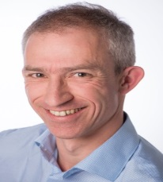




Conclusion
What about that world record?
Mutual integration of Oracle PaaS Cloud services is becoming more natural
The current Oracle PaaS palette offers many options for implementing Platform components
There is some overlap
There is some lack of obvious integration
And there are more services to be added – so next year, a new record!

Slide 38
Data Vizualization
DBaaS
ACCS
LA
ICS
APM
LA
OMC
(APM, LA)
SOA CS
ADF
SOAP
REST
JCS
APM
LA

